Slide 1
Xetroc 1.0
F.B.

Slide 2
From 0 and 1 to CPU

Slide 3
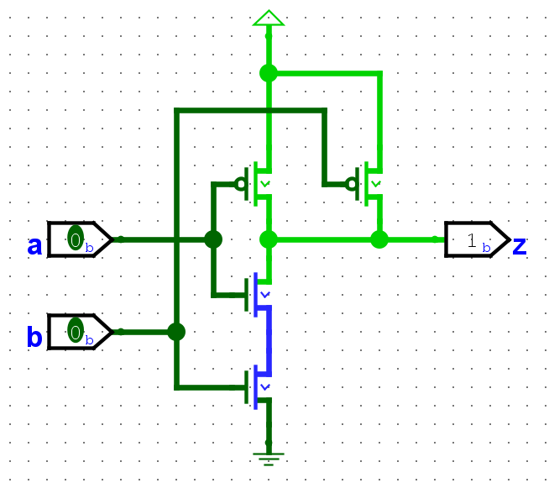
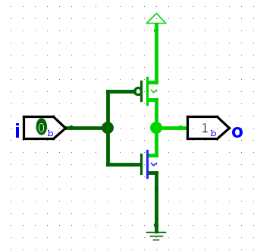
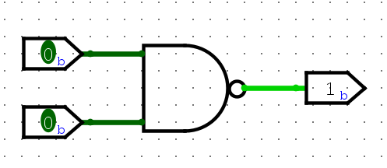
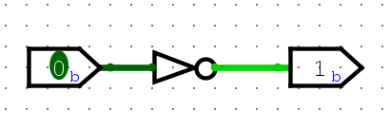
Inverter & NAND Gate

Slide 4
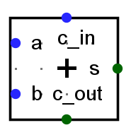
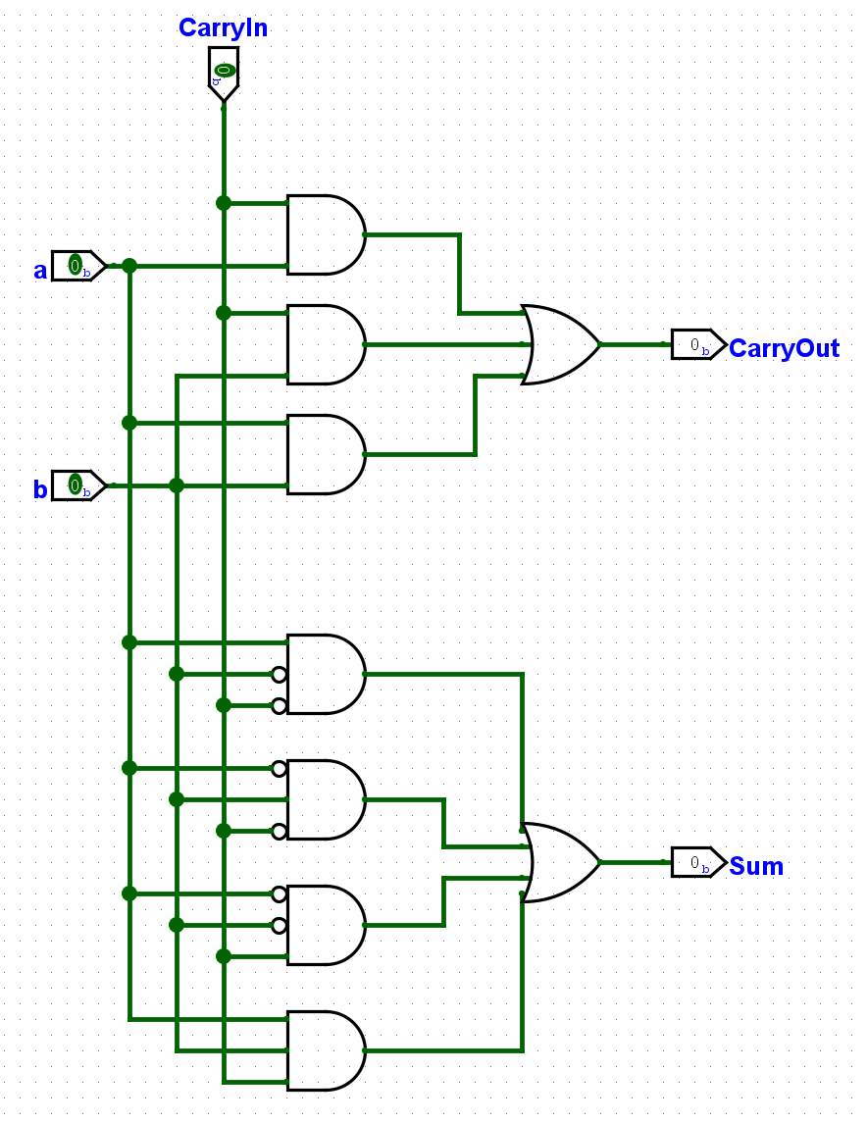
1-Bit Adder
CarryIn a b | CarryOut Sum
~~~~~~~~~~~~~~~~~~~~~~~~~~
0 0 0 | 0 0
0 0 1 | 0 1
0 1 0 | 0 1
0 1 1 | 1 0
1 0 0 | 0 1
1 0 1 | 1 0
1 1 0 | 1 0
1 1 1 | 1 1

Slide 5
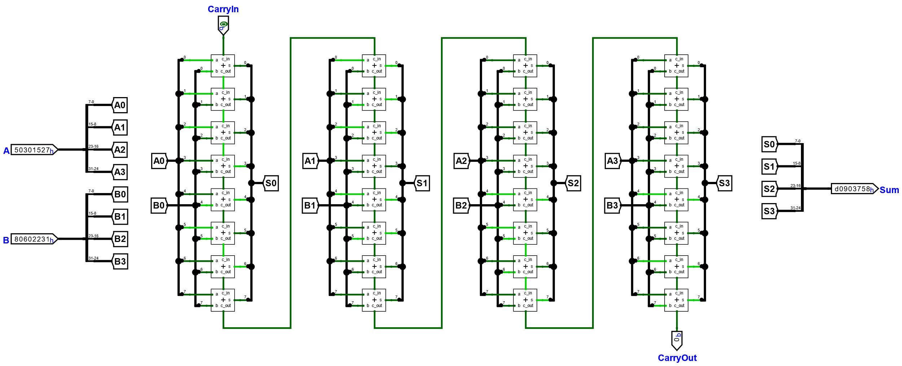
32-Bit Adder (Carry Ripple Adder)

Slide 6
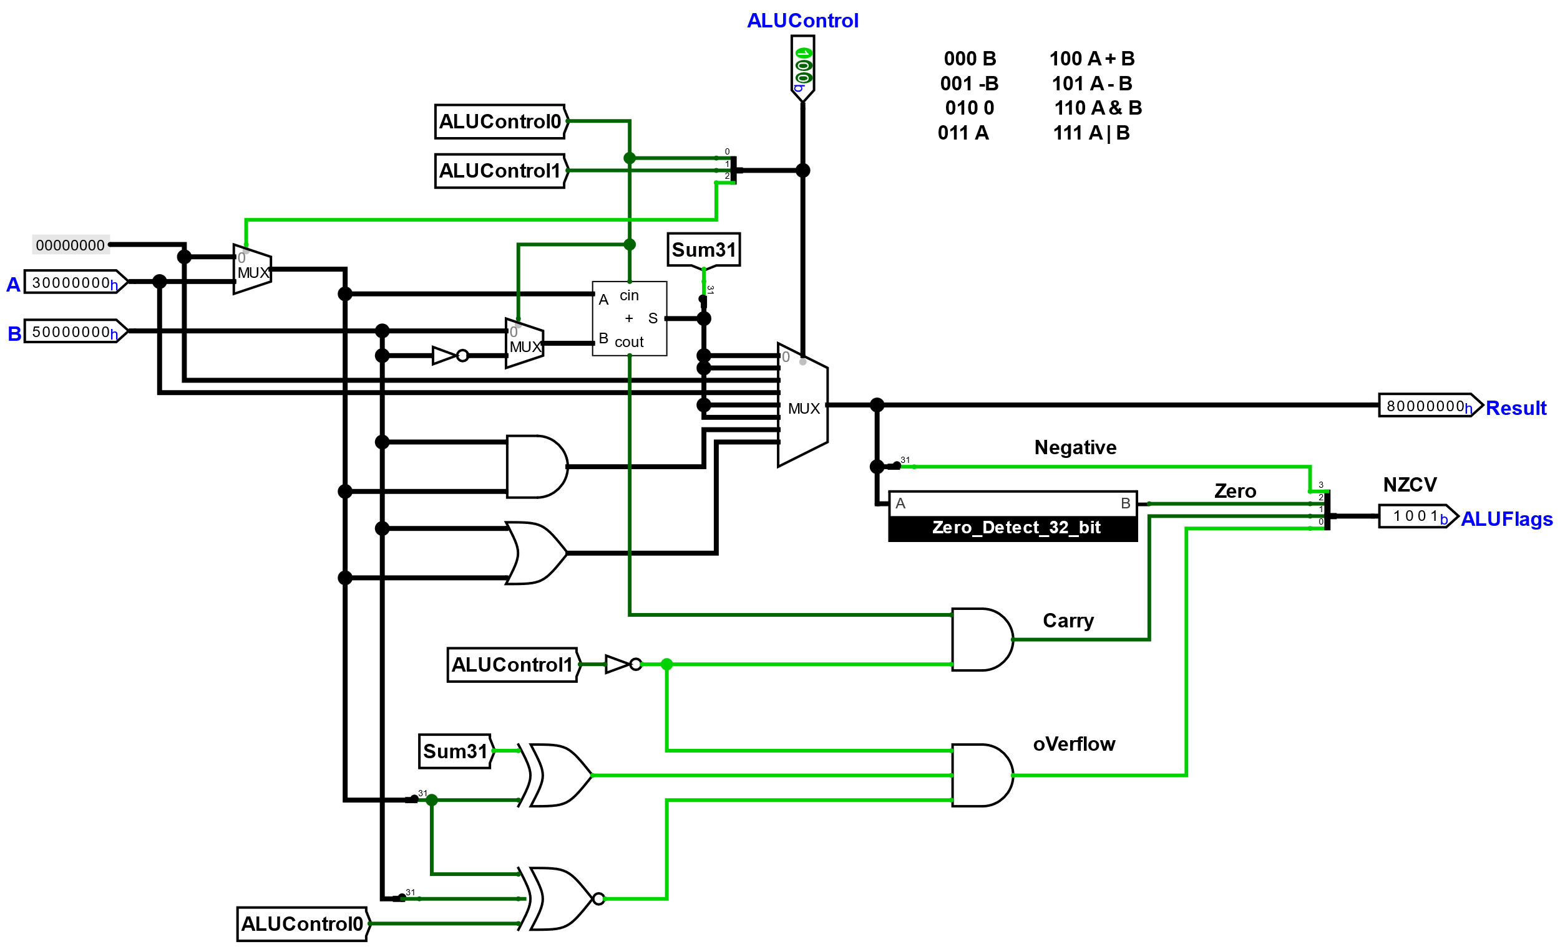
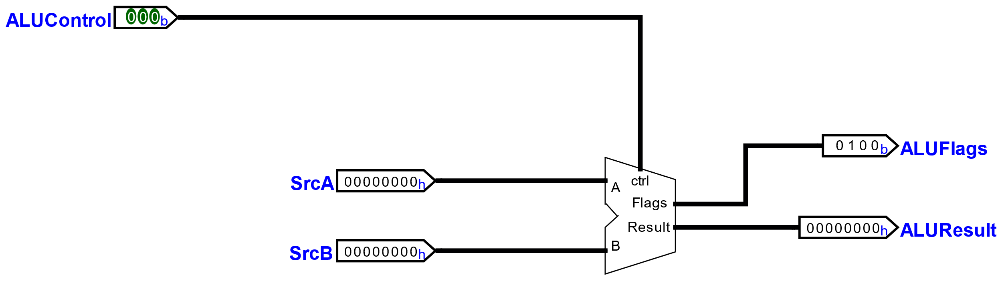
ALU
ALUControl | 0 | 0 | 0 | B
 | 0 | 0 | 1 | -B
 | 0 | 1 | 0 | 0
 | 0 | 1 | 1 | A
 | 1 | 0 | 0 | A + B
 | 1 | 0 | 1 | A – B
 | 1 | 1 | 0 | A & B
 | 1 | 1 | 1 | A | B

Slide 7
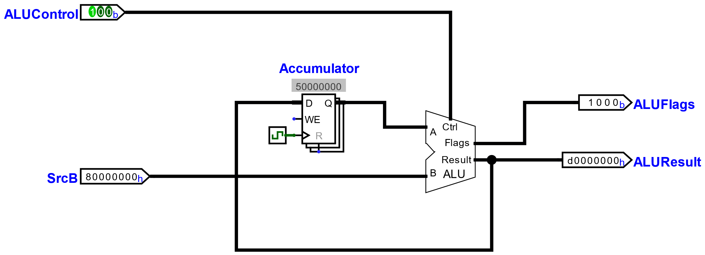
ALU with Accumulator
D-Flipflop (MS) | D | WE | R | CLK | Q'
(used for all registers) | 0 | 0 | 0 | x | Q | no change
 | 1 | 0 | 0 | x | Q | no change
 | x | x | 1 | x | 0 | static reset
 | 0 | 1 | 0 | ↑ | 0 | edge triggered write
 | 1 | 1 | 0 | ↑ | 1 | edge triggered write

Slide 8
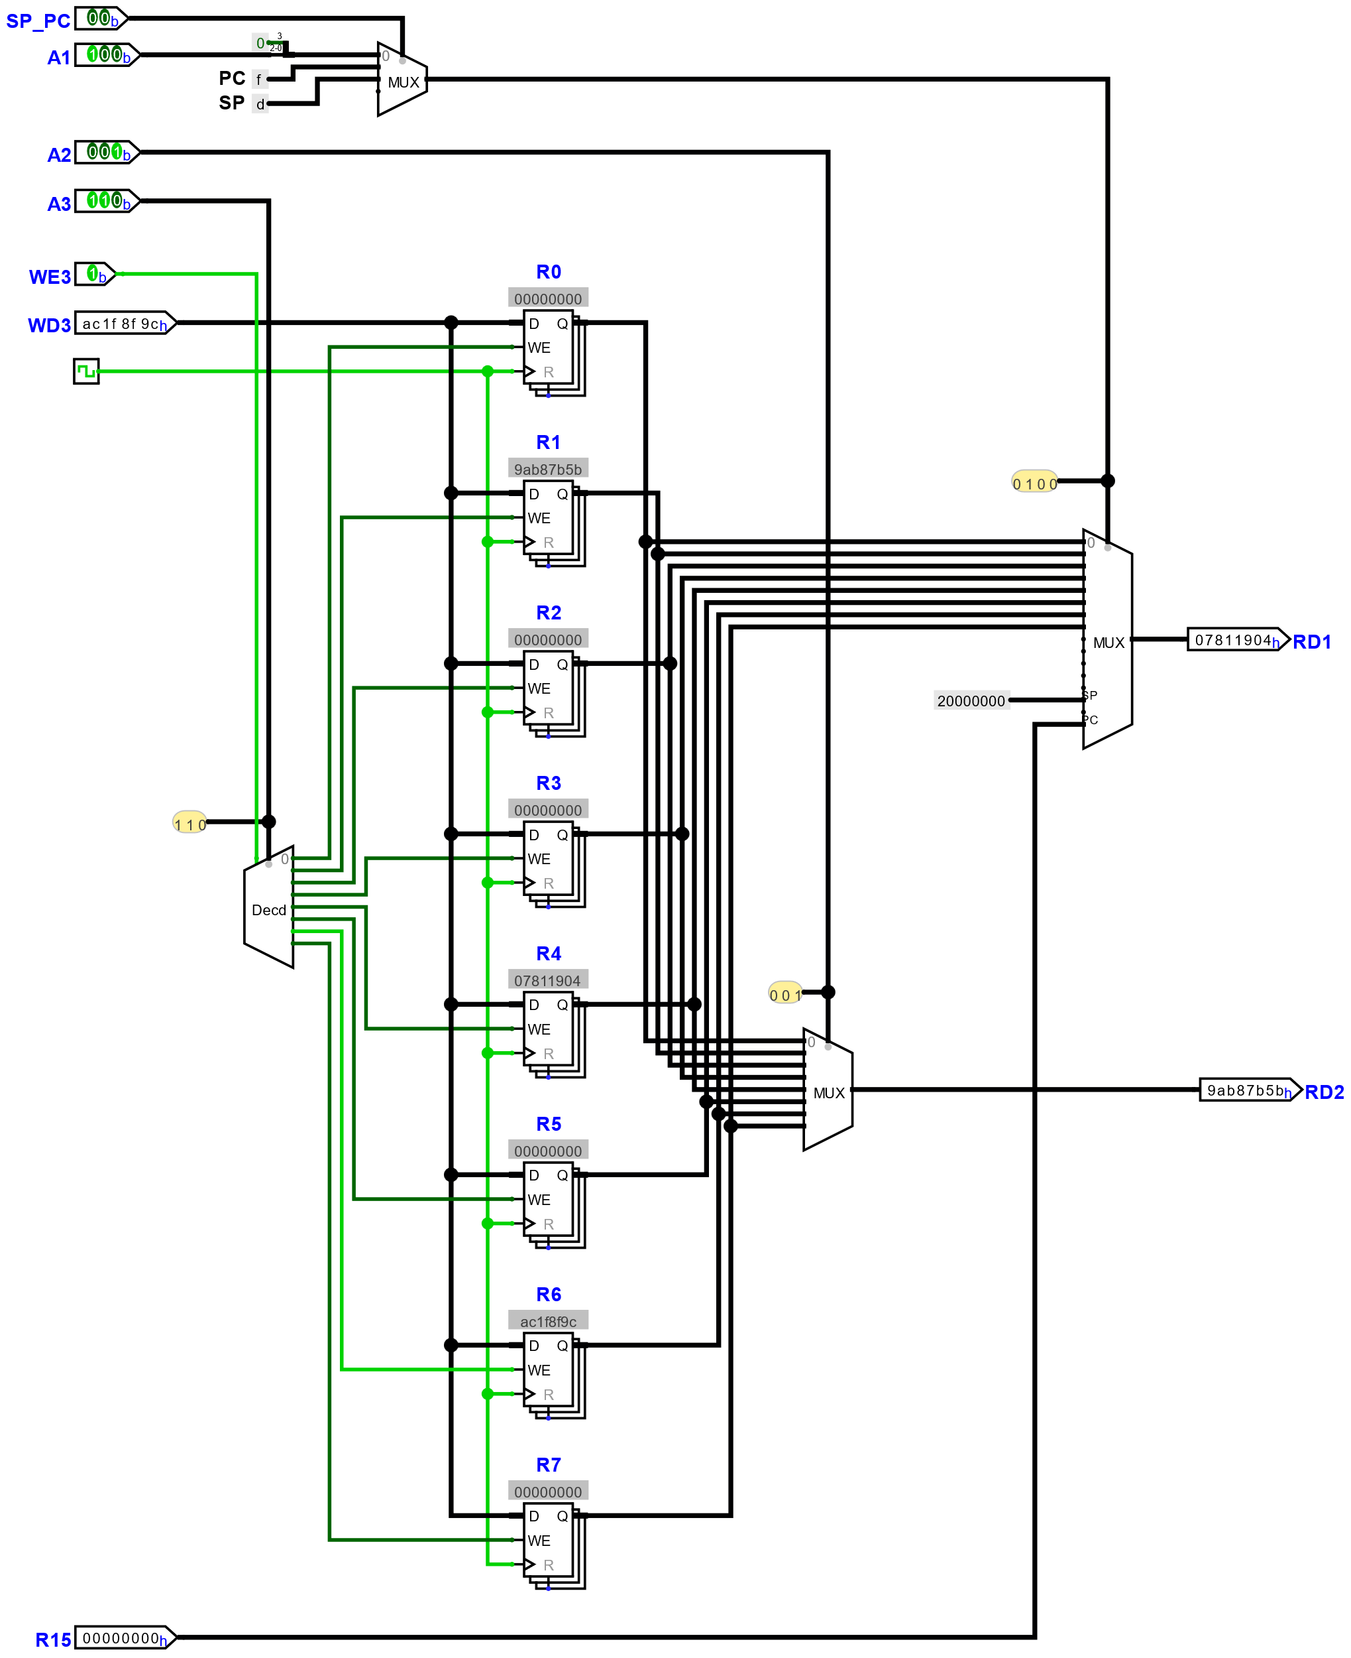
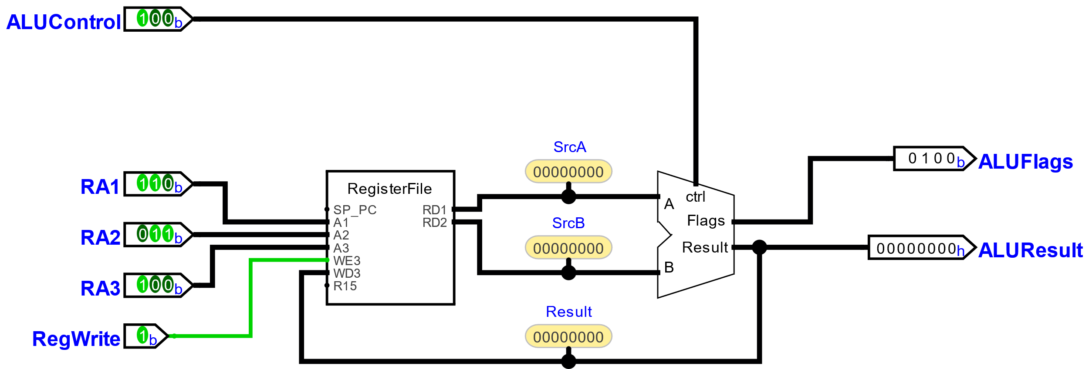
ALU with Register File

Slide 9
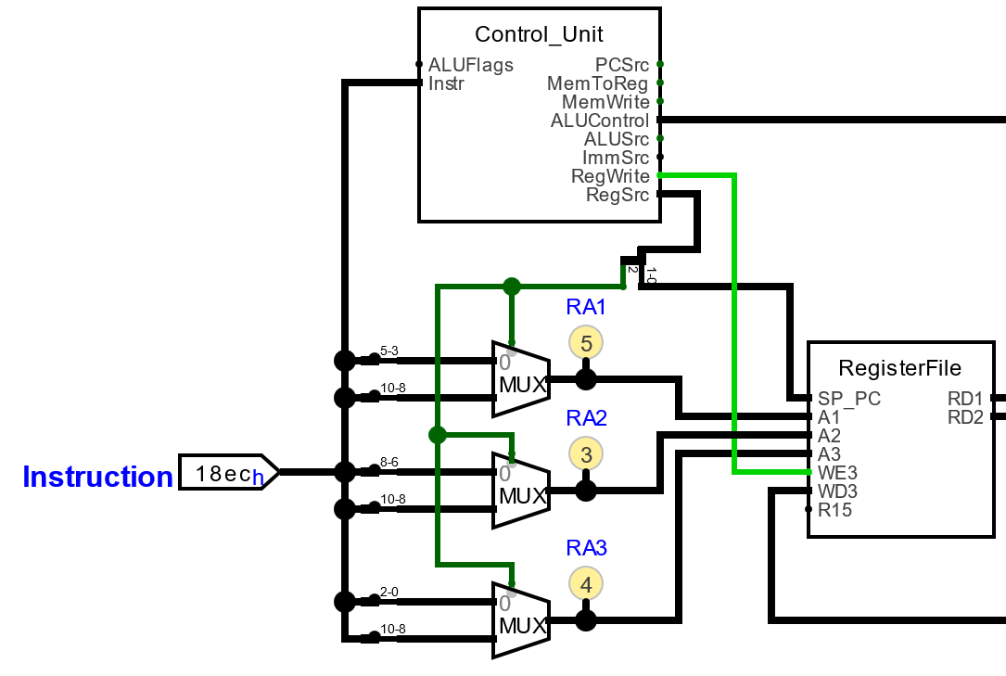
Instruction Encoding
RegSrc |  | 0 | 0 | use RA1 for A1
 |  | 0 | 1 | use PC for A1
 |  | 1 | 0 | use SP for A1
 | 0 |  |  | use individual bits for RAi
 | 1 |  |  | use bits 10..8 for all RAi
 | instruction encoding |  |  |  |  |  |  |  |  |  |  |  |  |  |  |  | assembler
15 |  |  |  |  |  |  | 8 |  |  |  |  |  |  |  | 0
0 | 0 | 0 | 0 | 0 | 0 | 0 | 0 | 0 | 0 | n | n | n | d | d | d |  | MOVS <Rd>,<Rn>
0 | 0 | 0 | 1 | 1 | 0 | 0 | m | m | m | n | n | n | d | d | d |  | ADDS <Rd>,<Rn>,<Rm>
0 | 0 | 0 | 1 | 1 | 0 | 1 | m | m | m | n | n | n | d | d | d |  | SUBS <Rd>,<Rn>,<Rm>
0 | 0 | 1 | 0 | 0 | d | d | d | i | i | i | i | i | i | i | i |  | MOVS <Rd>, #<imm8>
0 | 0 | 1 | 1 | 0 | dn | dn | dn | i | i | i | i | i | i | i | i |  | ADDS <Rdn>,#<imm8>
0 | 0 | 1 | 1 | 1 | dn | dn | dn | i | i | i | i | i | i | i | i |  | SUBS <Rdn>,#<imm8>
1 | 0 | 0 | 1 | 1 | t | t | t | i | i | i | i | i | i | i | i |  | LDR <Rt>,[<SP>,#<imm8>]
1 | 0 | 0 | 1 | 0 | t | t | t | i | i | i | i | i | i | i | i |  | STR <Rt>,[<SP>,#<imm8>]
1 | 1 | 0 | 1 | c | c | c | c | i | i | i | i | i | i | i | i |  | Bcc #<simm8>
1 | 1 | 1 | 0 | 0 | i | i | i | i | i | i | i | i | i | i | i |  | B #<simm11>

Slide 10
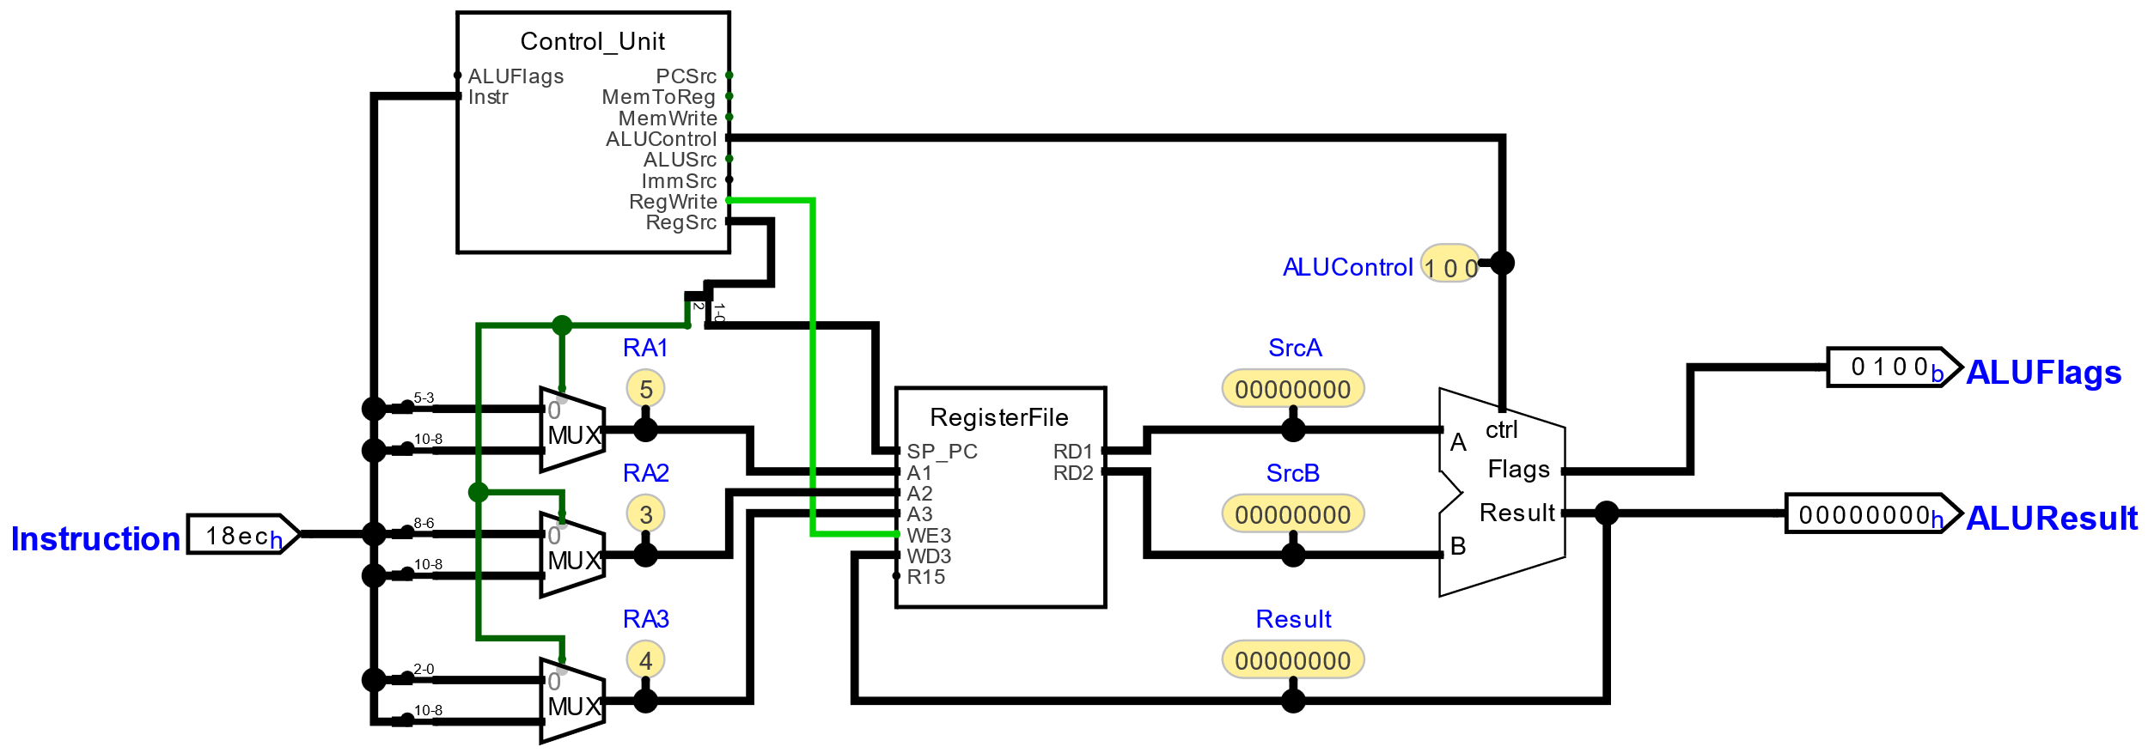
Instruction Decoder & Control Unit
0 | 0 | 0 | 0 | 0 | 0 | 0 | 0 | 0 | 0 | n | n | n | d | d | d |  | MOVS <Rd>,<Rn>
0 | 0 | 0 | 1 | 1 | 0 | 0 | m | m | m | n | n | n | d | d | d |  | ADDS <Rd>,<Rn>,<Rm>
0 | 0 | 0 | 1 | 1 | 0 | 1 | m | m | m | n | n | n | d | d | d |  | SUBS <Rd>,<Rn>,<Rm>

Slide 11
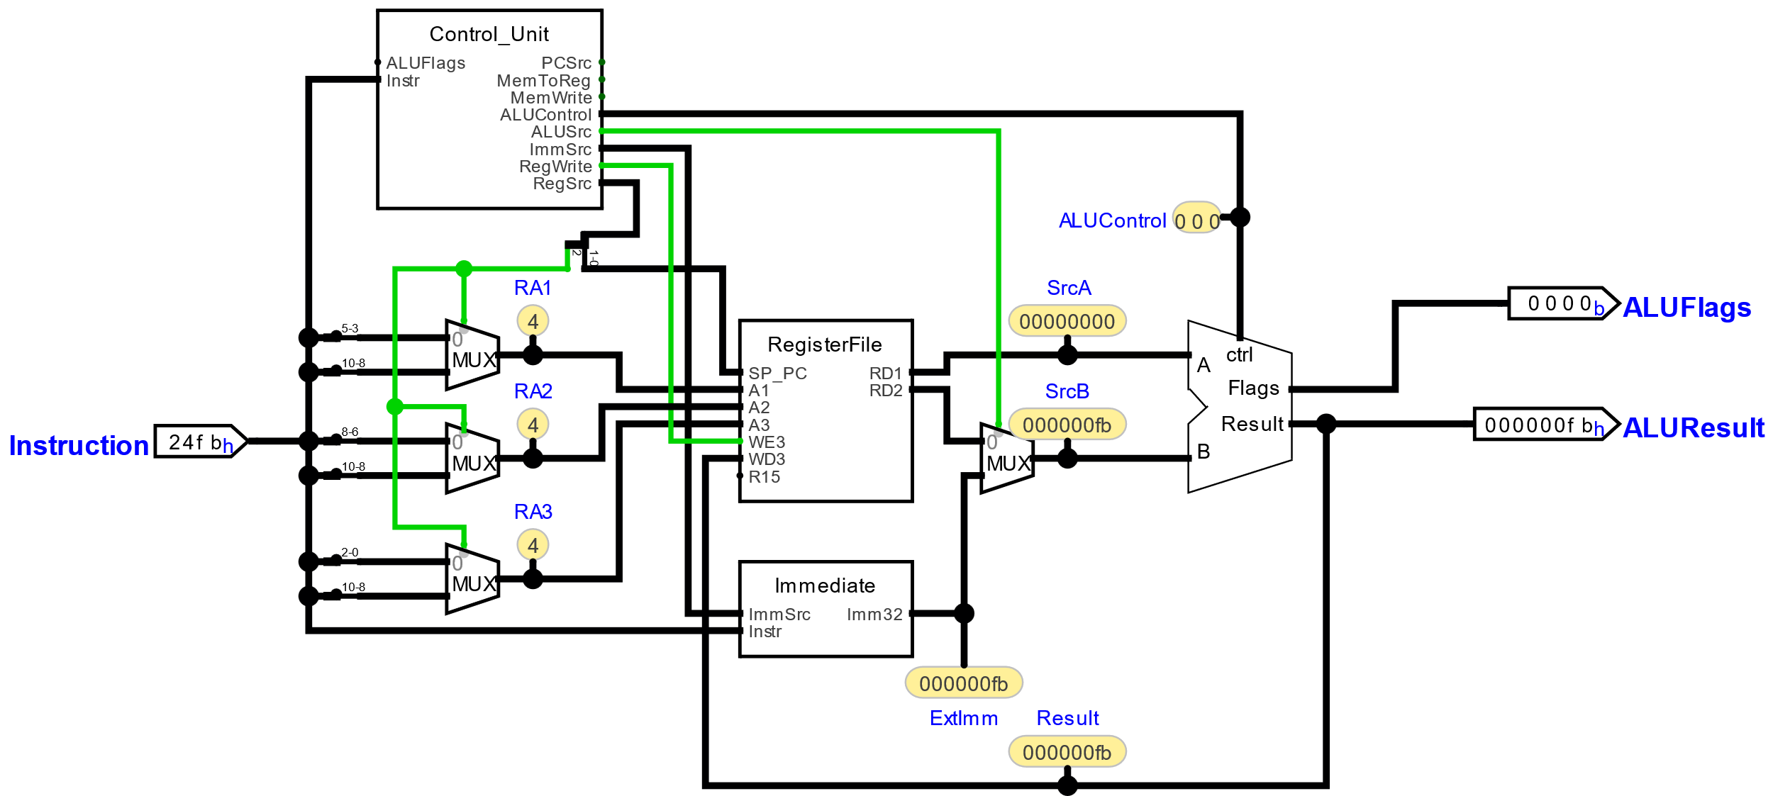
Immediate Operands
ImmSrc | 0 | 0 | imm8
 | 0 | 1 | imm8 << 2
 | 1 | 0 | simm8 << 1
 | 1 | 1 | simm11 << 1
0 | 0 | 1 | 0 | 0 | d | d | d | i | i | i | i | i | i | i | i |  | MOVS <Rd>, #<imm8>
0 | 0 | 1 | 1 | 0 | dn | dn | dn | i | i | i | i | i | i | i | i |  | ADDS <Rdn>,#<imm8>
0 | 0 | 1 | 1 | 1 | dn | dn | dn | i | i | i | i | i | i | i | i |  | SUBS <Rdn>,#<imm8>

Slide 12
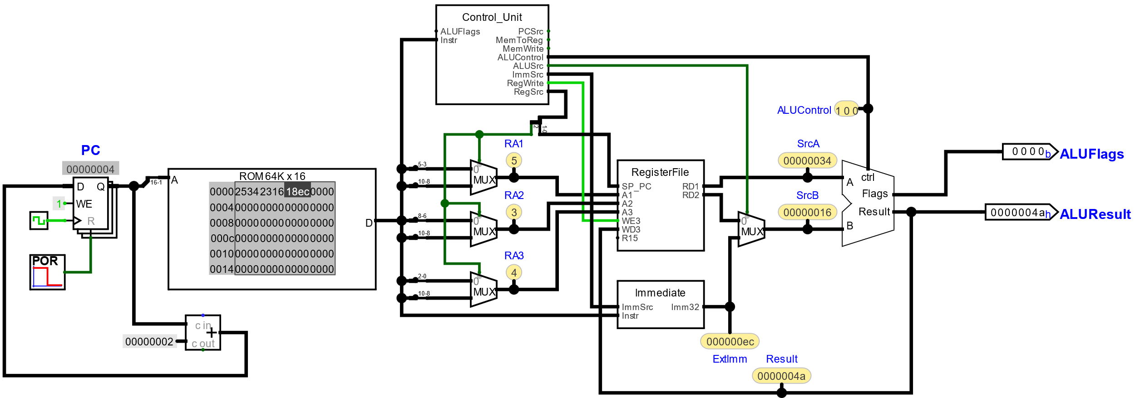
Instruction Memory
ROM | A | D
 | a | ROM[a] |  | static read

Slide 13
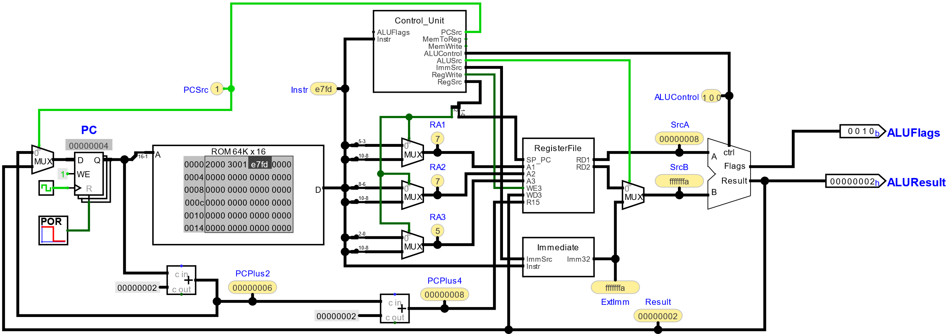
Branch
1 | 1 | 1 | 0 | 0 | i | i | i | i | i | i | i | i | i | i | i

Slide 14
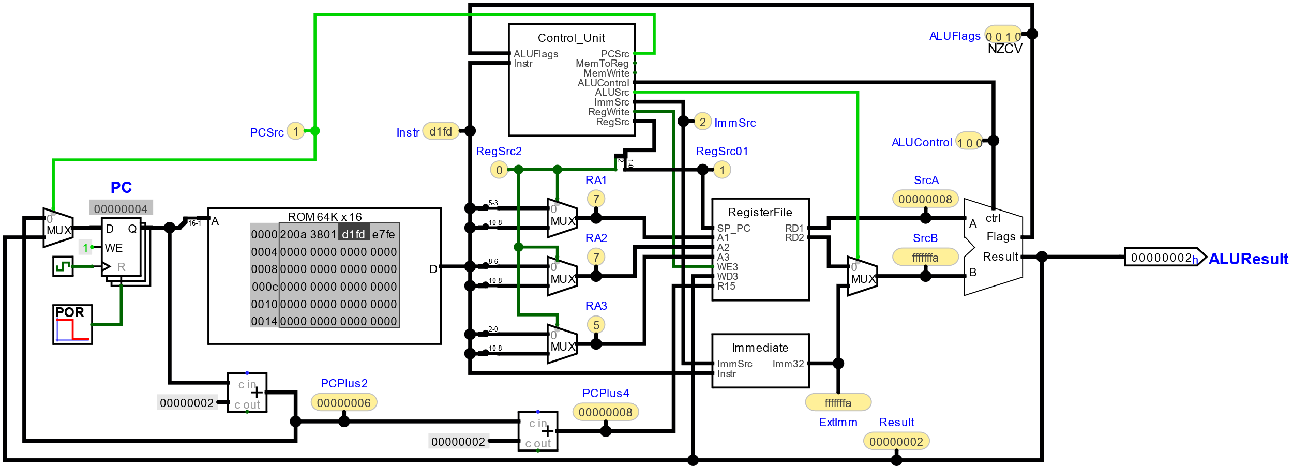
Conditional Branch
Code |  |  |  | Condition | Meaning | Status of Flags
0 | 0 | 0 | 0 | EQ | Equal | Z==1
0 | 0 | 0 | 1 | NE | Not Equal | Z==0
0 | 0 | 1 | 0 | CS or HS | Unsigned Higher or Same (or Carry Set) | C==1
0 | 0 | 1 | 1 | CC or LO | Unsigned Lower (or Carry Clear) | C==0
0 | 1 | 0 | 0 | MI | Negative (or Minus) | N==1
0 | 1 | 0 | 1 | PL | Positive (or Plus) | N==0
0 | 1 | 1 | 0 | VS | Signed Overflow | V==1
0 | 1 | 1 | 1 | VC | No signed Overflow | V==0
1 | 0 | 0 | 0 | HI | Unsigned Higher | (C==1) && (Z!=0)
1 | 0 | 0 | 1 | LS | Unsigned Lower or same | (C==0) || (Z==0)
1 | 0 | 1 | 0 | GE | Signed Greater Than or Equal | N==V
1 | 0 | 1 | 1 | LT | Signed Less Than | N!=V
1 | 1 | 0 | 0 | GT | Signed Greater Than | (Z==0) && (N==V)
1 | 1 | 0 | 1 | LE | Signed Less Than or Equal | (Z==1) || (N!=V)
1 | 1 | 1 | 0 | AL | Always executed | true
1 | 1 | 1 | 1 | NV | Never executed | false
1 | 1 | 0 | 1 | c | c | c | c | i | i | i | i | i | i | i | i

Slide 15
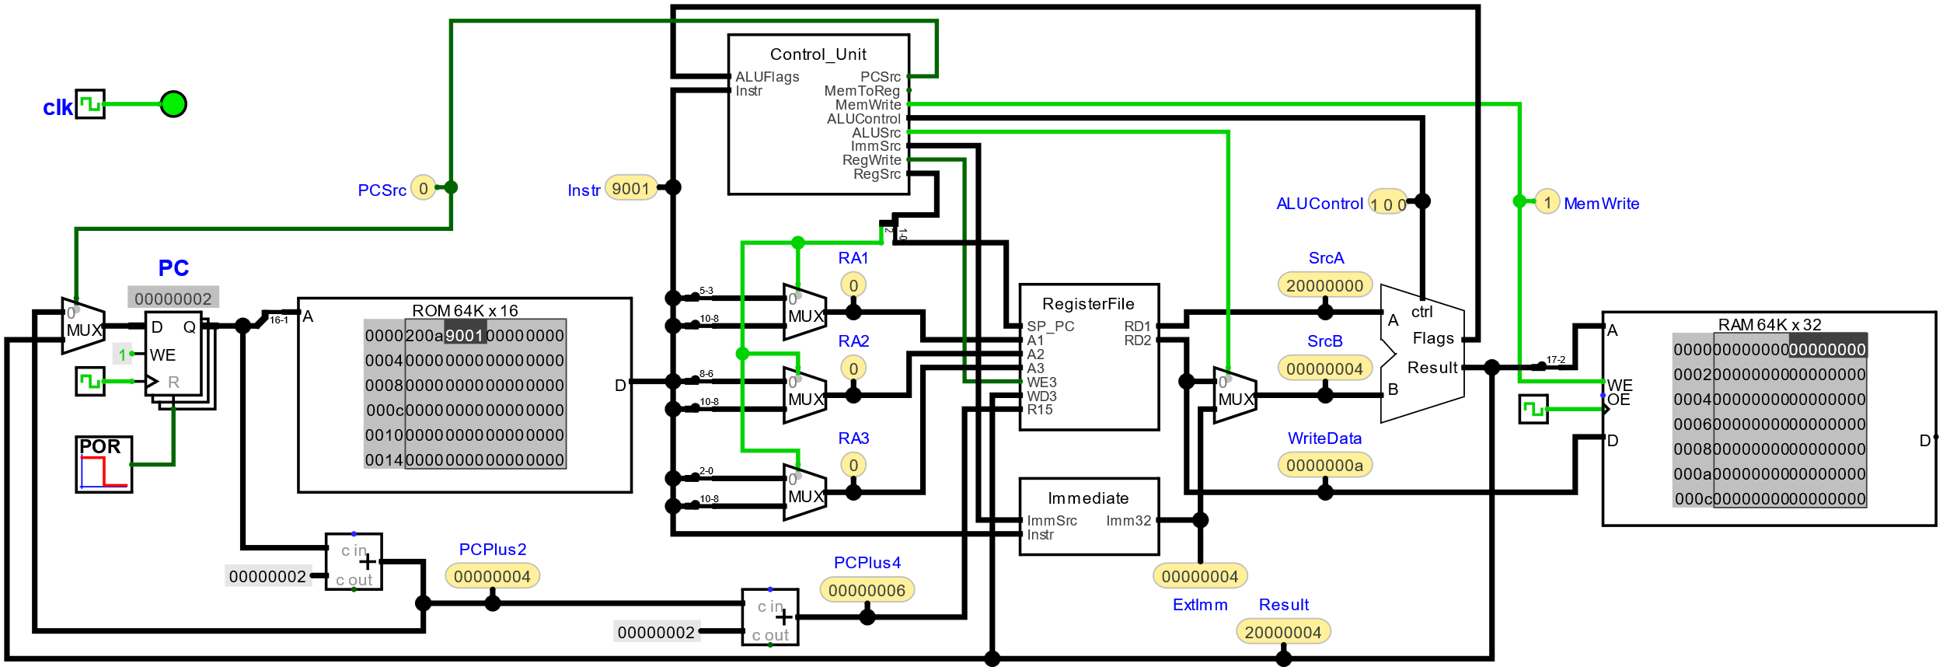
Store to Data Memory
RAM | C | WE | OE | A | Din | Dout
 | x | x | 1 | a |  | RAM[a] | static read
 | ↑ | 1 | x | a | RAM[a] = Din |  | rising edge triggered write
1 | 0 | 0 | 1 | 0 | t | t | t | i | i | i | i | i | i | i | i

Slide 16
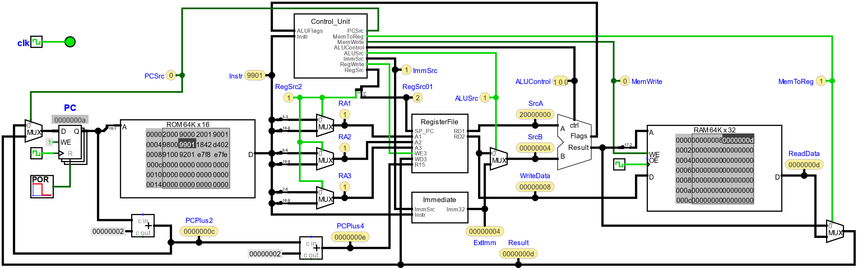
Load from Data Memory
RAM | C | WE | OE | A | Din | Dout
 | x | x | 1 | a |  | RAM[a] | static read
 | ↑ | 1 | x | a | RAM[a] = Din |  | rising edge triggered write
1 | 0 | 0 | 1 | 1 | t | t | t | i | i | i | i | i | i | i | i

Slide 17
Instructions

Slide 18
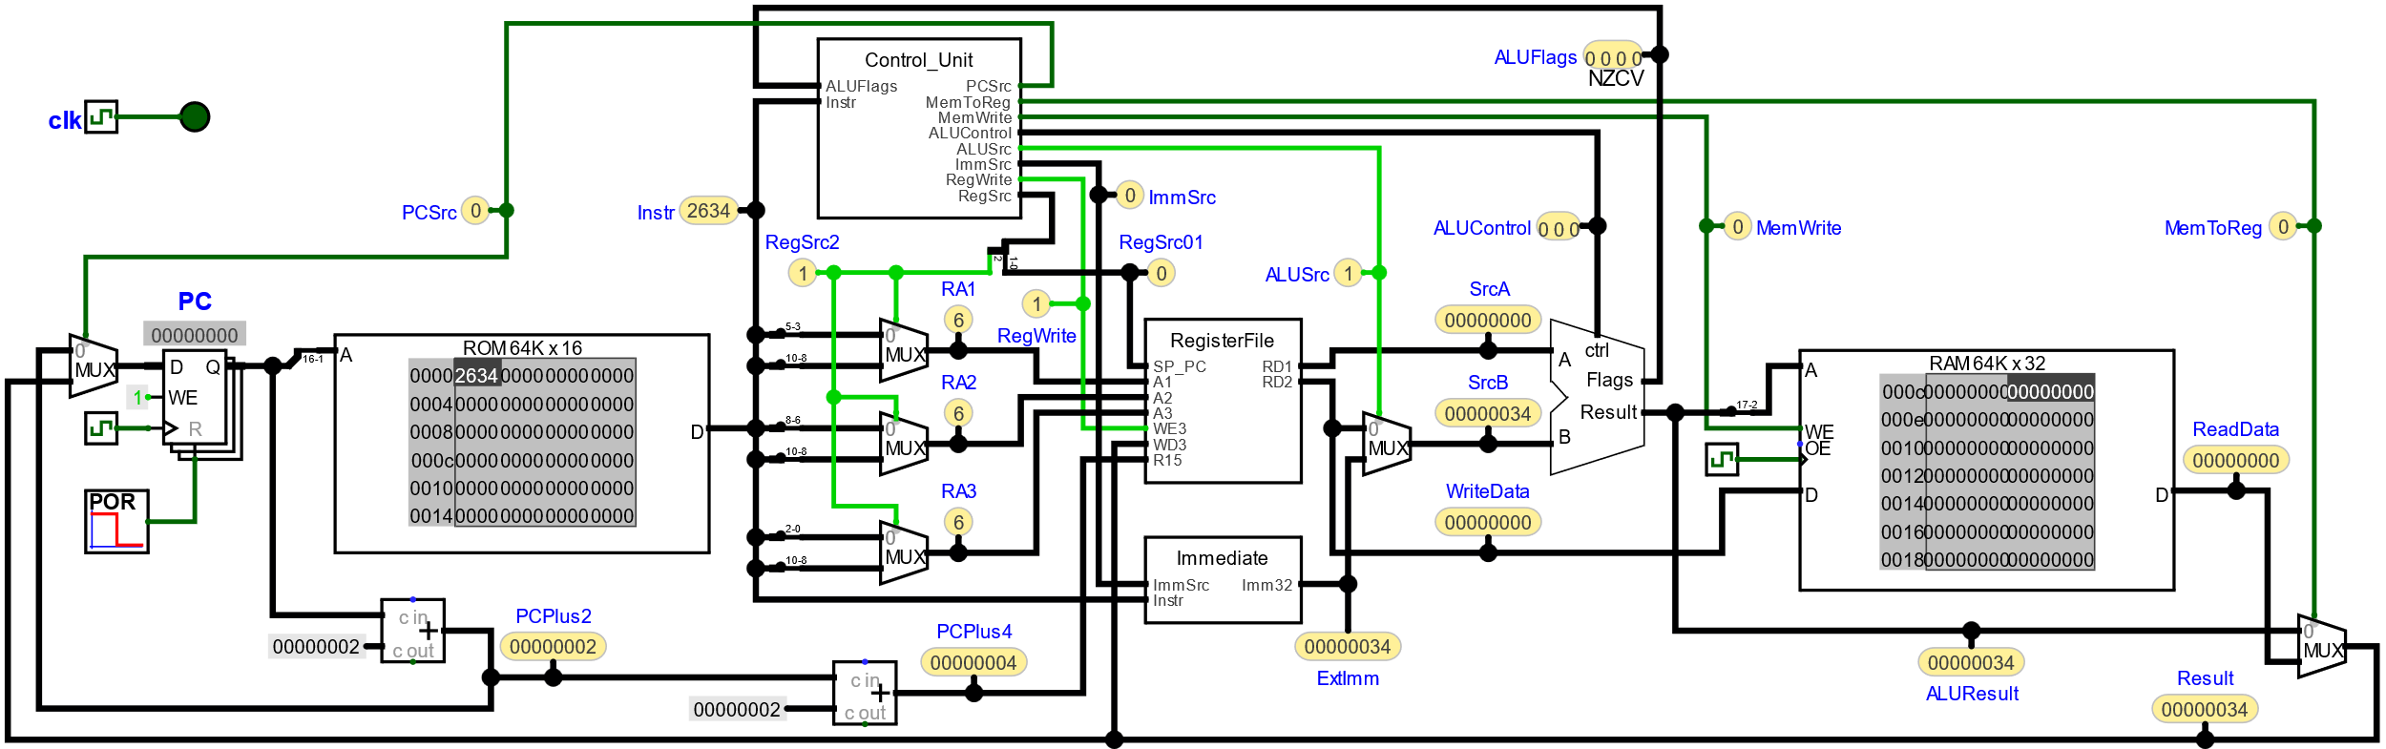
MOVS <Rd>, #<imm8>
ImmSrc | 0 | 0 |  | imm8
 | 0 | 1 |  | imm8 << 2
 | 1 | 0 |  | simm8 << 1
 | 1 | 1 |  | simm11 << 1
ALUControl | 0 | 0 | 0 |  | B
 | 0 | 0 | 1 |  | -B
 | 0 | 1 | 0 |  | 0
 | 0 | 1 | 1 |  | A
 | 1 | 0 | 0 |  | A+B
 | 1 | 0 | 1 |  | A-B
 | 1 | 1 | 0 |  | A&B
 | 1 | 1 | 1 |  | A|B
00 10 0 Rd. ....imm8

Slide 19

ADDS <Rdn>, #<imm8>
ImmSrc | 0 | 0 |  | imm8
 | 0 | 1 |  | imm8 << 2
 | 1 | 0 |  | simm8 << 1
 | 1 | 1 |  | simm11 << 1
ALUControl | 0 | 0 | 0 |  | B
 | 0 | 0 | 1 |  | -B
 | 0 | 1 | 0 |  | 0
 | 0 | 1 | 1 |  | A
 | 1 | 0 | 0 |  | A+B
 | 1 | 0 | 1 |  | A-B
 | 1 | 1 | 0 |  | A&B
 | 1 | 1 | 1 |  | A|B
00 11 0 Rdn ....imm8

Slide 20
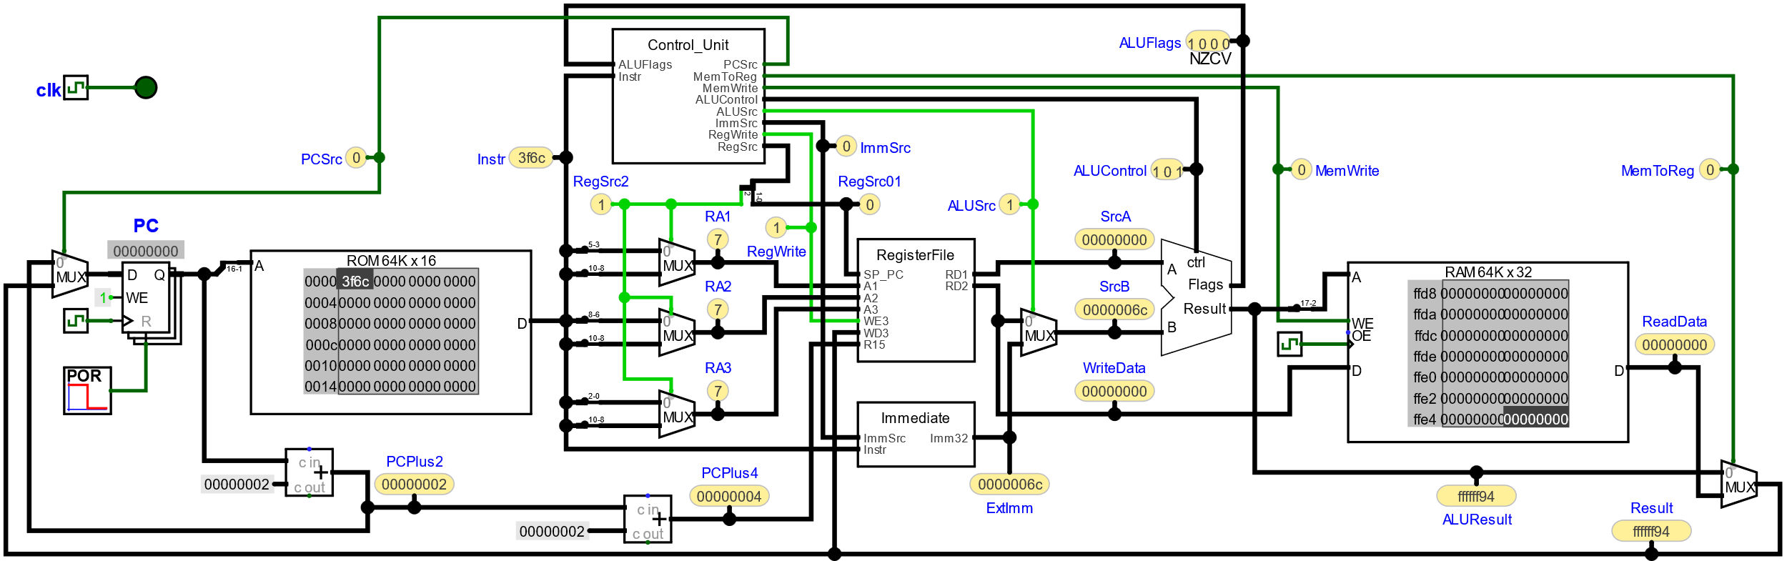
SUBS <Rdn>, #<imm8>
ImmSrc | 0 | 0 |  | imm8
 | 0 | 1 |  | imm8 << 2
 | 1 | 0 |  | simm8 << 1
 | 1 | 1 |  | simm11 << 1
ALUControl | 0 | 0 | 0 |  | B
 | 0 | 0 | 1 |  | -B
 | 0 | 1 | 0 |  | 0
 | 0 | 1 | 1 |  | A
 | 1 | 0 | 0 |  | A+B
 | 1 | 0 | 1 |  | A-B
 | 1 | 1 | 0 |  | A&B
 | 1 | 1 | 1 |  | A|B
00 11 1 Rdn ....imm8

Slide 21
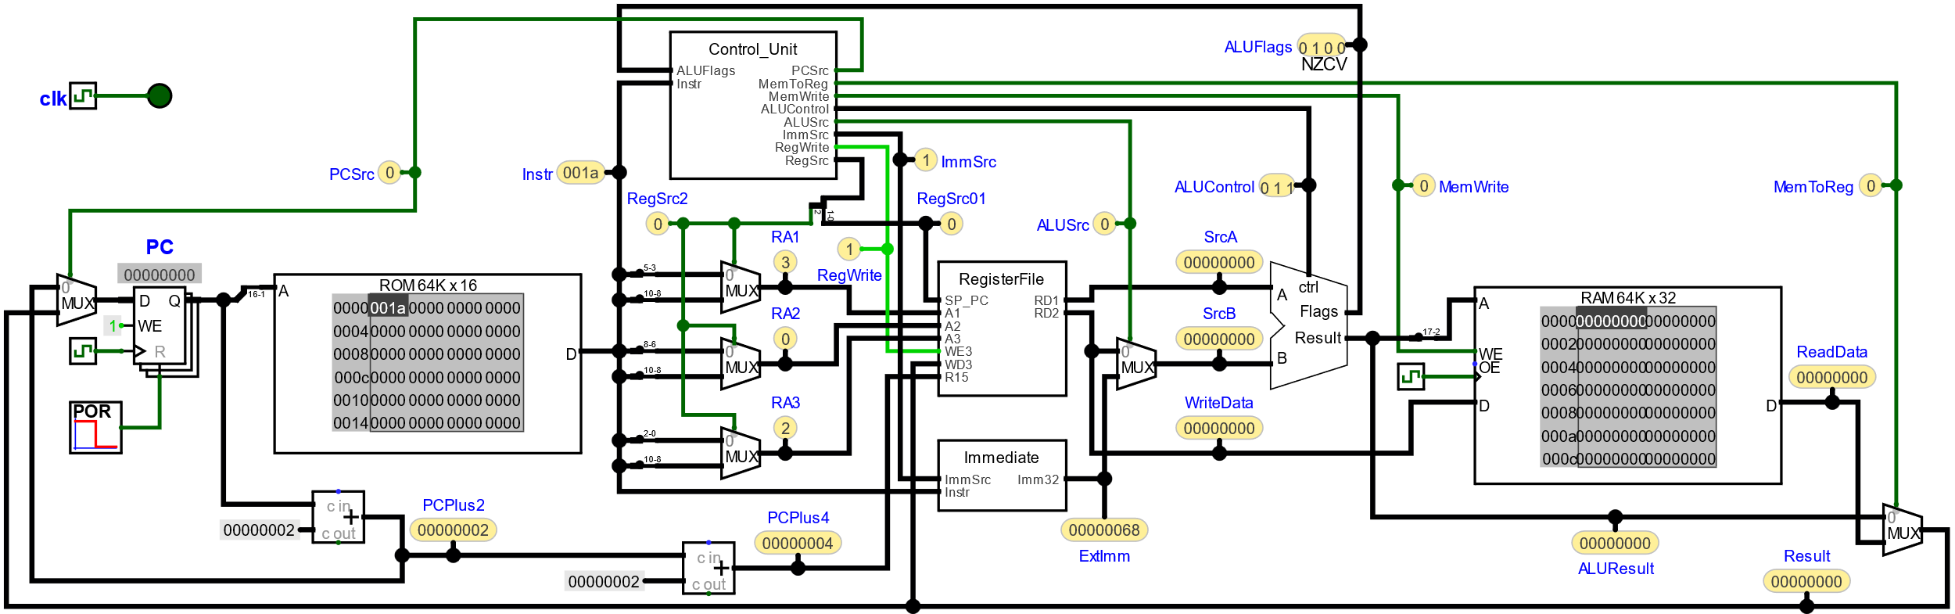
MOVS <Rd>,<Rm>
ImmSrc | 0 | 0 |  | imm8
 | 0 | 1 |  | imm8 << 2
 | 1 | 0 |  | simm8 << 1
 | 1 | 1 |  | simm11 << 1
ALUControl | 0 | 0 | 0 |  | B
 | 0 | 0 | 1 |  | -B
 | 0 | 1 | 0 |  | 0
 | 0 | 1 | 1 |  | A
 | 1 | 0 | 0 |  | A+B
 | 1 | 0 | 1 |  | A-B
 | 1 | 1 | 0 |  | A&B
 | 1 | 1 | 1 |  | A|B
00 00 0 00000 Rm. Rd.

Slide 22

ADDS <Rd>,<Rn>,<Rm>
ImmSrc | 0 | 0 |  | imm8
 | 0 | 1 |  | imm8 << 2
 | 1 | 0 |  | simm8 << 1
 | 1 | 1 |  | simm11 << 1
ALUControl | 0 | 0 | 0 |  | B
 | 0 | 0 | 1 |  | -B
 | 0 | 1 | 0 |  | 0
 | 0 | 1 | 1 |  | A
 | 1 | 0 | 0 |  | A+B
 | 1 | 0 | 1 |  | A-B
 | 1 | 1 | 0 |  | A&B
 | 1 | 1 | 1 |  | A|B
00 01 1 00 Rm. Rn. Rd.

Slide 23

SUBS <Rd>,<Rn>,<Rm>
ImmSrc | 0 | 0 |  | imm8
 | 0 | 1 |  | imm8 << 2
 | 1 | 0 |  | simm8 << 1
 | 1 | 1 |  | simm11 << 1
ALUControl | 0 | 0 | 0 |  | B
 | 0 | 0 | 1 |  | -B
 | 0 | 1 | 0 |  | 0
 | 0 | 1 | 1 |  | A
 | 1 | 0 | 0 |  | A+B
 | 1 | 0 | 1 |  | A-B
 | 1 | 1 | 0 |  | A&B
 | 1 | 1 | 1 |  | A|B
00 01 1 01 Rm. Rn. Rd.

Slide 24
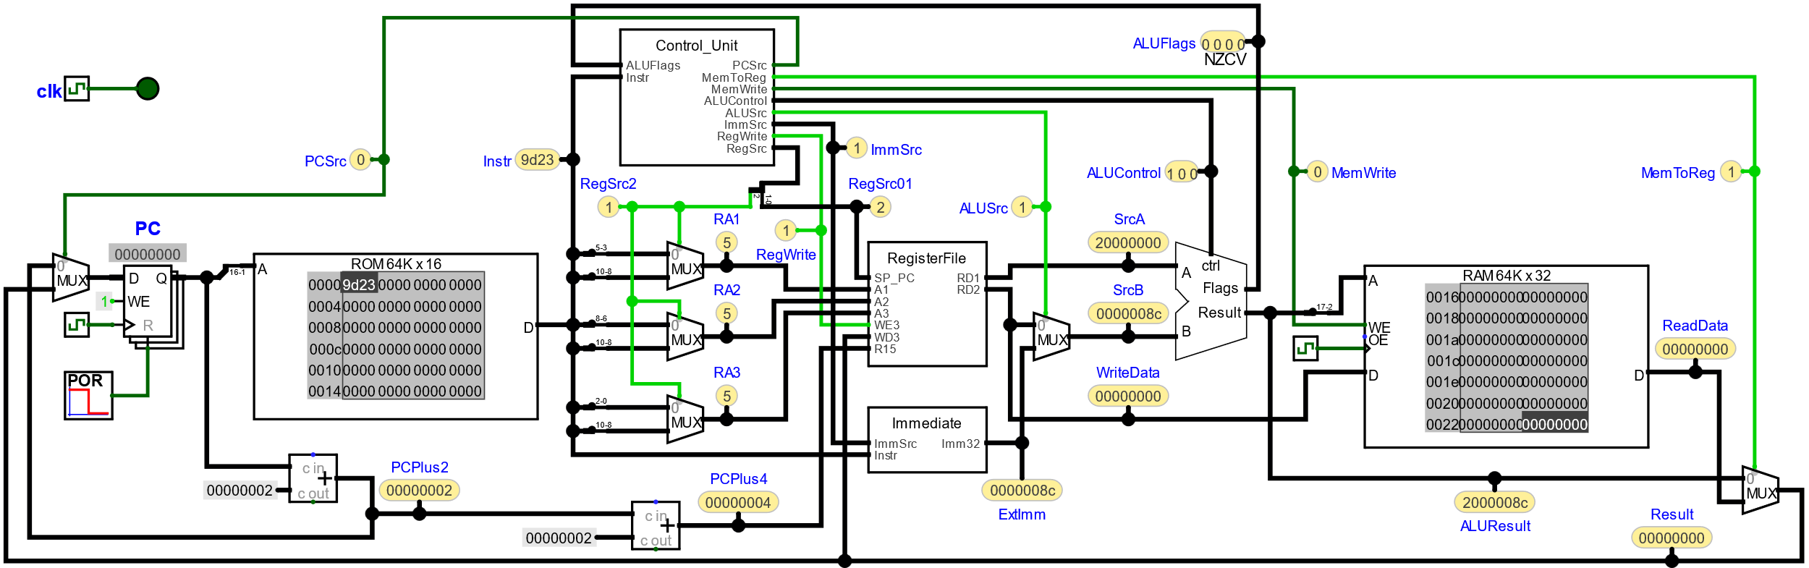
LDR <Rt>, [SP, #<imm8>]
ImmSrc | 0 | 0 |  | imm8
 | 0 | 1 |  | imm8 << 2
 | 1 | 0 |  | simm8 << 1
 | 1 | 1 |  | simm11 << 1
ALUControl | 0 | 0 | 0 |  | B
 | 0 | 0 | 1 |  | -B
 | 0 | 1 | 0 |  | 0
 | 0 | 1 | 1 |  | A
 | 1 | 0 | 0 |  | A+B
 | 1 | 0 | 1 |  | A-B
 | 1 | 1 | 0 |  | A&B
 | 1 | 1 | 1 |  | A|B
10 01 1 Rt. ....imm8

Slide 25
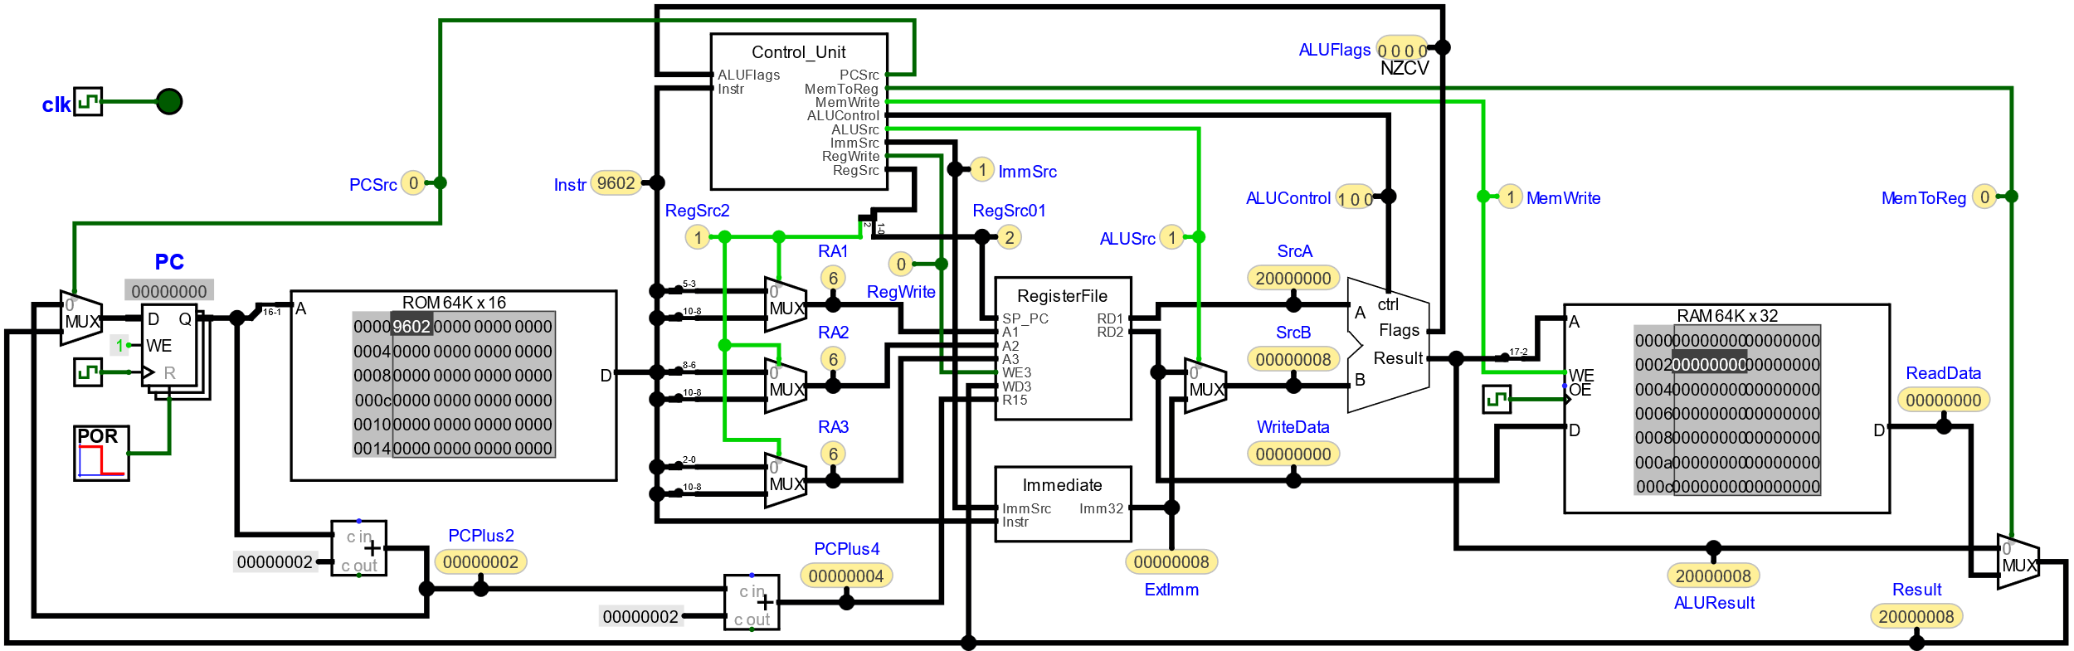
STR <Rt>, [SP, #<imm8>]
ImmSrc | 0 | 0 |  | imm8
 | 0 | 1 |  | imm8 << 2
 | 1 | 0 |  | simm8 << 1
 | 1 | 1 |  | simm11 << 1
ALUControl | 0 | 0 | 0 |  | B
 | 0 | 0 | 1 |  | -B
 | 0 | 1 | 0 |  | 0
 | 0 | 1 | 1 |  | A
 | 1 | 0 | 0 |  | A+B
 | 1 | 0 | 1 |  | A-B
 | 1 | 1 | 0 |  | A&B
 | 1 | 1 | 1 |  | A|B
10 01 0 Rt. ....imm8

Slide 26
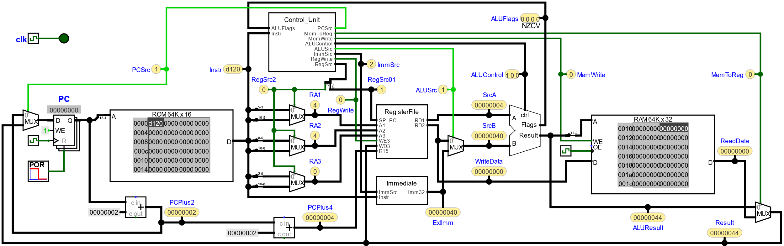
Bcc #<simm8>
ImmSrc | 0 | 0 |  | imm8
 | 0 | 1 |  | imm8 << 2
 | 1 | 0 |  | simm8 << 1
 | 1 | 1 |  | simm11 << 1
ALUControl | 0 | 0 | 0 |  | B
 | 0 | 0 | 1 |  | -B
 | 0 | 1 | 0 |  | 0
 | 0 | 1 | 1 |  | A
 | 1 | 0 | 0 |  | A+B
 | 1 | 0 | 1 |  | A-B
 | 1 | 1 | 0 |  | A&B
 | 1 | 1 | 1 |  | A|B
11 01 cond ...simm8

Slide 27
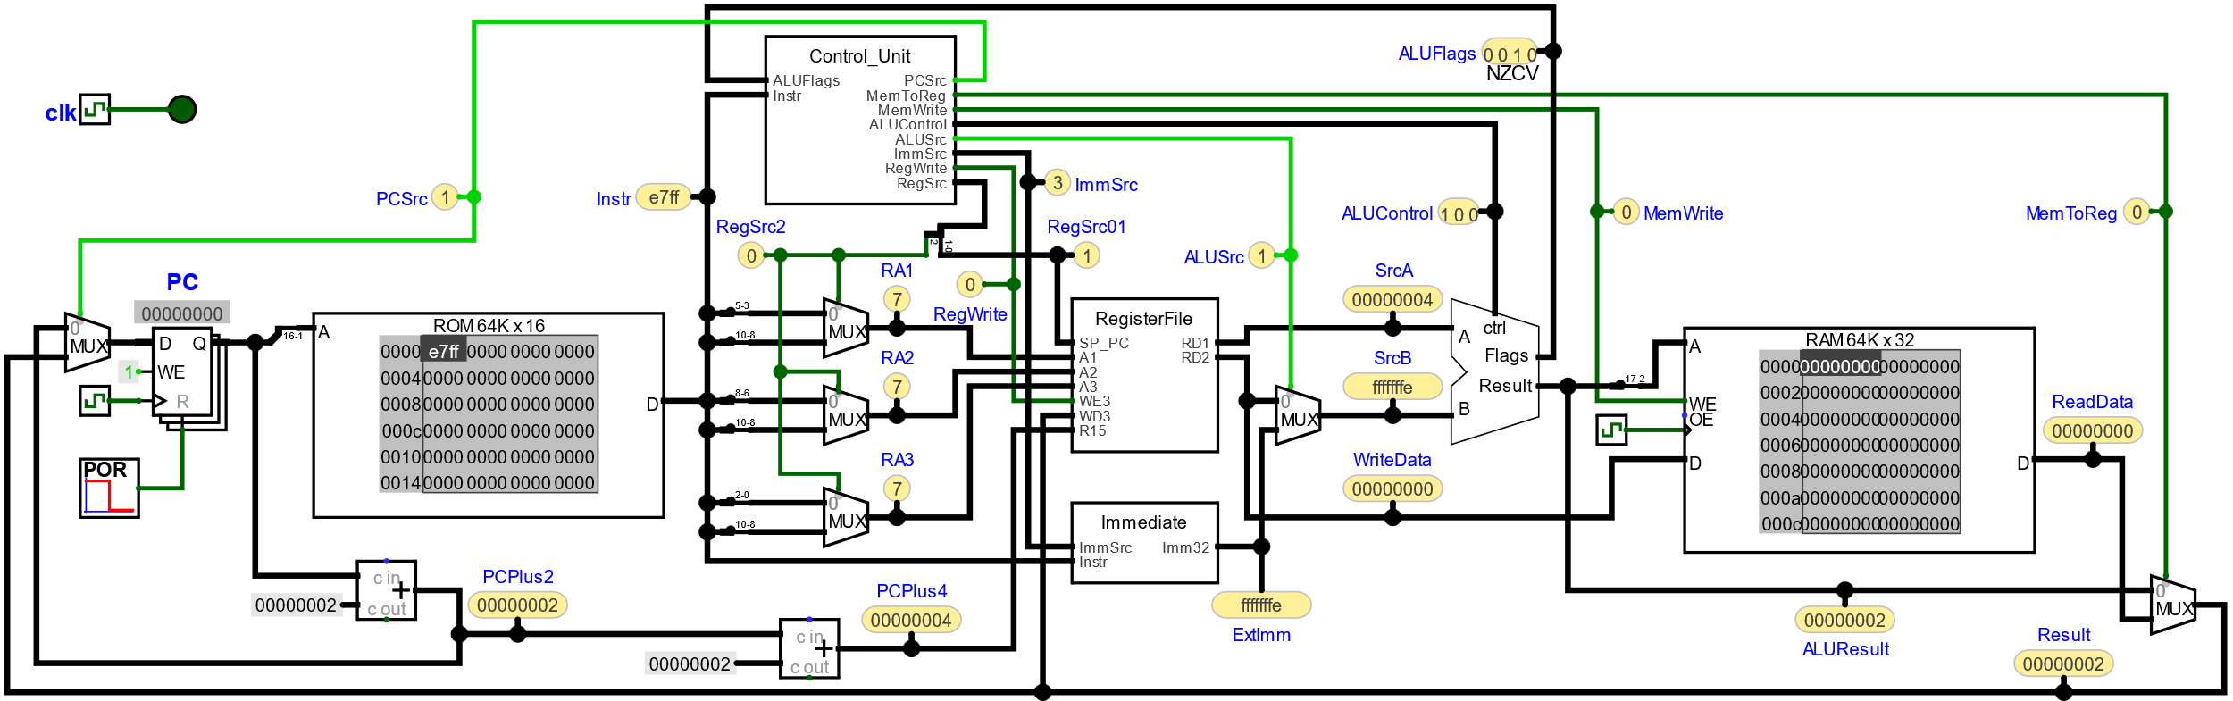
B #<simm11>
ImmSrc | 0 | 0 |  | imm8
 | 0 | 1 |  | imm8 << 2
 | 1 | 0 |  | simm8 << 1
 | 1 | 1 |  | simm11 << 1
ALUControl | 0 | 0 | 0 |  | B
 | 0 | 0 | 1 |  | -B
 | 0 | 1 | 0 |  | 0
 | 0 | 1 | 1 |  | A
 | 1 | 0 | 0 |  | A+B
 | 1 | 0 | 1 |  | A-B
 | 1 | 1 | 0 |  | A&B
 | 1 | 1 | 1 |  | A|B
11 10 0 .....simm11

Slide 28
Timing Diagrams

Slide 29
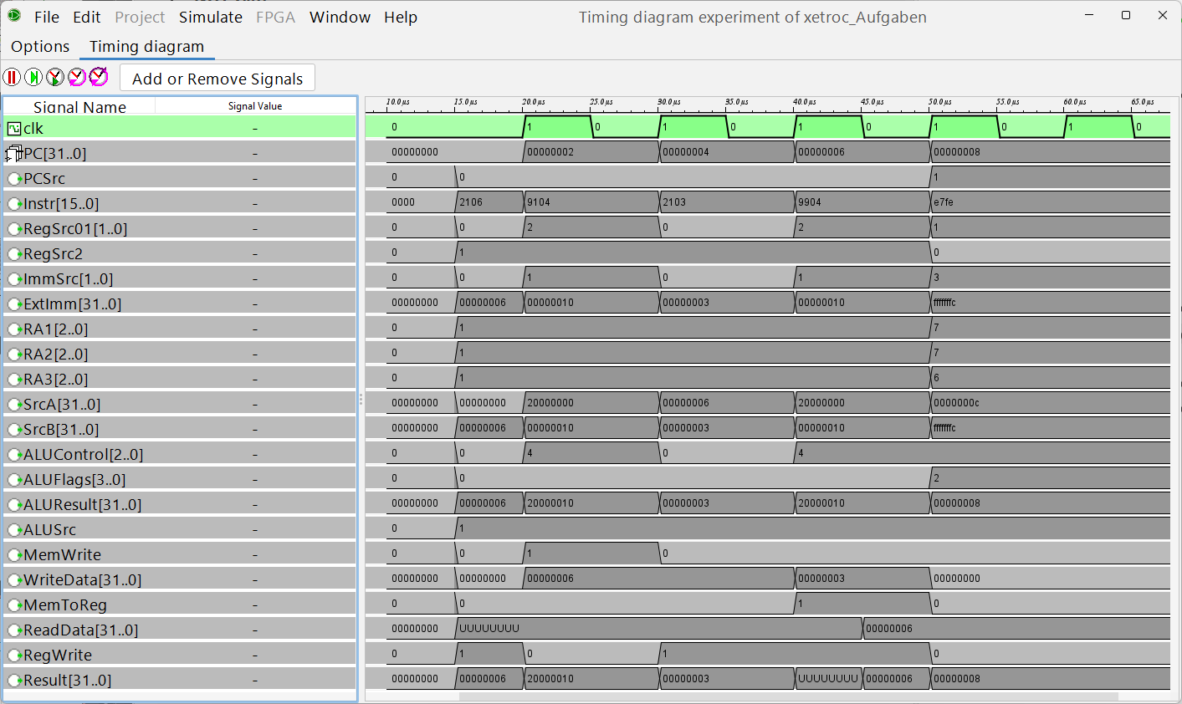
movs r1, #6
str r1, [sp, #4]
movs r1, #3
ldr r1, [sp, #4]
b .
Notes:
No POR; sync ram, falling edge, read after write, FPGA supported
The first instruction cycle has no clk.
Registers are written at thew rising edge.

